Slide 1
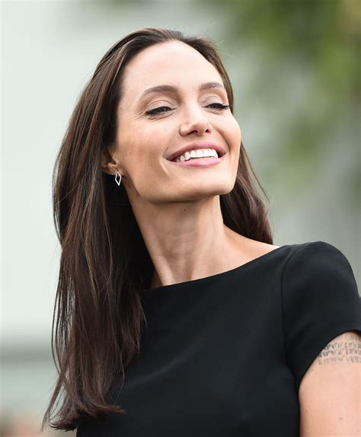
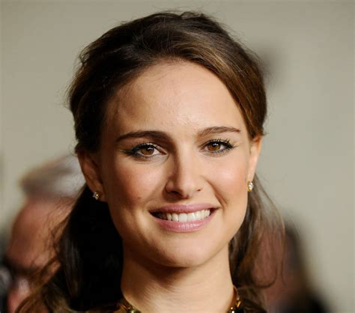
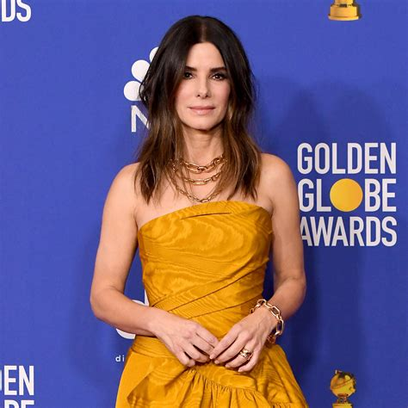
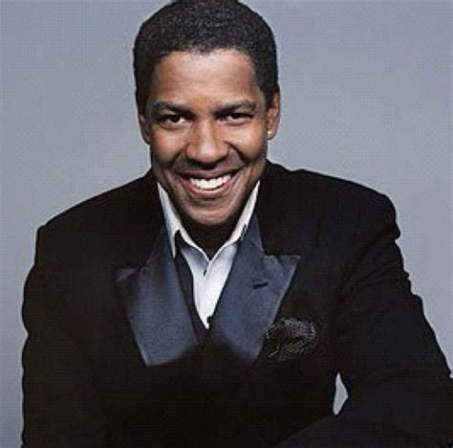
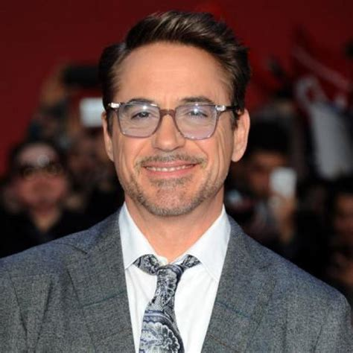
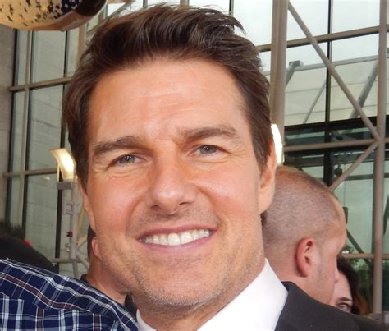
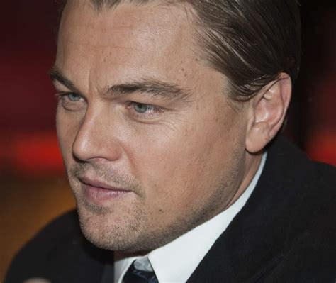
Celebrity faces dataset
By Tajwar Fahmid

Slide 2
About the Dataset:
Dataset with folders of images of celebrities.
Size of the dataset: 55 MB
17 different folders = 17 different classes
100 images per folder of each celebrity.
Kaggle link to the dataset: https://www.kaggle.com/datasets/vishesh1412/celebrity-face-image-dataset/data

Slide 3
Our goal
Use the data provided in the dataset to train a CNN model.
Use that model to analyze new pictures of the celebrities.
Classify the images into one of the 17 different classes.

Slide 4
Dataset loading and initial look
Mounted google drive onto google colab.
Created a folder path and inspected the names of the folders.
Separated the files in the folders into two different sets: a training set and a validation set.
80 images per celeb in the training set and 20 in the validation set.

Slide 5
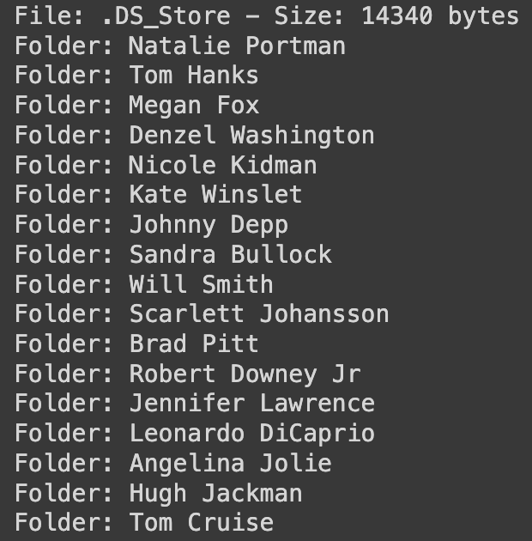
17 different classes and the contents of the training folder

Slide 6
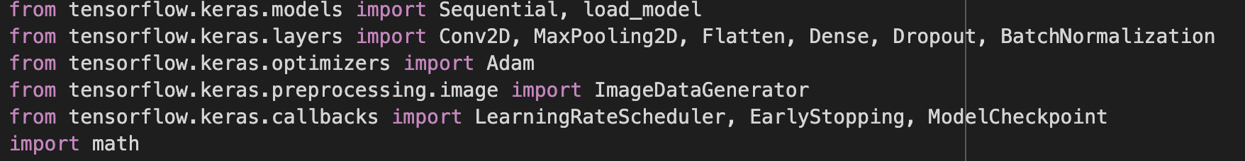
training THE MODEL
Imported the following libraries:

Slide 7
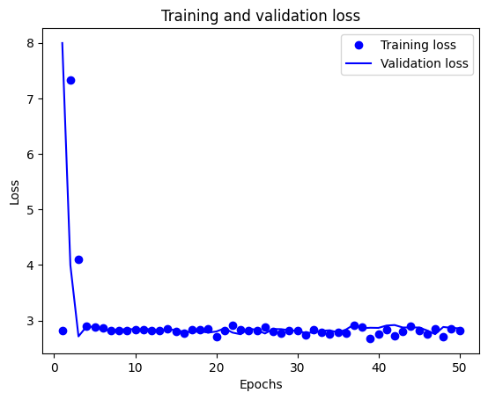
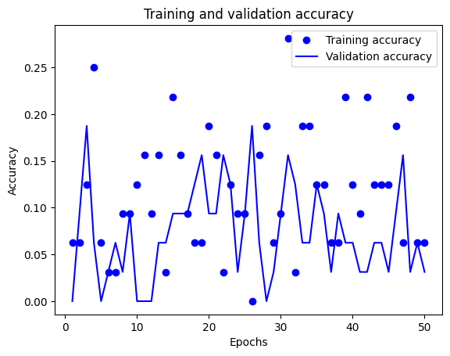
1st model results

Slide 8
Problems with first model
Kept classifying all new images of celebrities into the Scarlett Johansson class.
Problem of overfitting.
Accuracy graphs for training and validation were scattered and did not make any sense.

Slide 9
Modifications to the model
- Lower epochs (100 to 50) to counter overfitting problem.
Adjusted the image data generator for training data with specific augmentations for portraits.
Adjusted the learning rate.

Slide 10
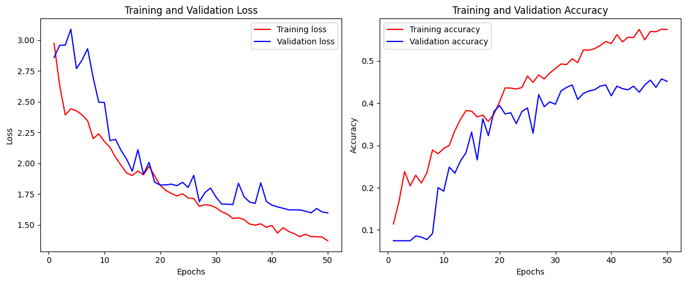
2nd MODEL RESULTS

Slide 11
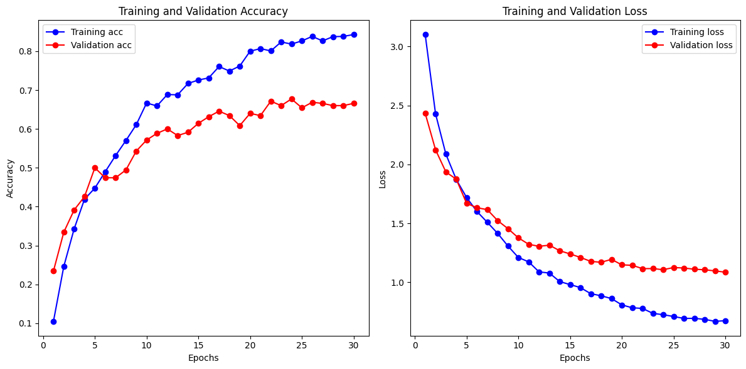
Transfer learning model
Used VGG16 as a base model.
Got a much better accuracy than any previous model. (0.54 to 0.67)
Graphs became much more stable.

Slide 12
Model Evaluation
Of the three models, the final transfer learning model with the VGG16 base and the specific augmentations was the most accurate (0.667 accuracy)
The model could make accurate predictions from new random images which the first model could not do.
However, the model could be further improved.
Another transfer learning model could have been tried (ResNet50) to compare the results.
Model is working but can be further improved.

